Slide 1

Week 8: It's That Simple
November 10, 2025

Slide 2


Week 8 Challenge: Snakes and Ladders
There are 36 spaces marked out (one desk = one space)
You need to get from the start to the finish as quickly as possible
You will pick a number from the hat to figure out how many spaces you are going
Whenever you get to the middle road you get to pick a snake or ladder
The snake and ladder choice will tell you how many rows you are going up or down
The first person to get to the finish or the person who is the farthest ahead after 12 minutes wins

Slide 3

RECAP
Last Week: Sit Down Be Humble
Korah, Dathan, Abiram and 250 other men started a rebellion against Moses and Aaron
Moses told them to each bring a censer with coal and incense, and told them that God would show who He chose to lead the Israelites
The next day they all brought their censers to the tent of meeting
Fire came out from the Lord and consumed the 250 men
The people rebelled again
The ground opened up and swallowed Korah, Dathan and Abiram along with their families and belongings
God told them to put a staff from the leader of each tribe, along with Aarons staff in front of the Ark of the Covenant
The next day Aarons staff budded, which showed the people that God had chosen Aaron as the chief priest
Notes:
After pt one explain how Jacobs roots can be traced back to Abraham and briefly explain the lineage
Pt 2, then explain how

Slide 4

Roadmap through the Wilderness
Israelites In Egypt (400 years)
Exodus from Egypt (weeks to months)
Journey in the wilderness (40 years)
Israelites in the Promised land (approximately 800 years)
After the Promised Land

Slide 5
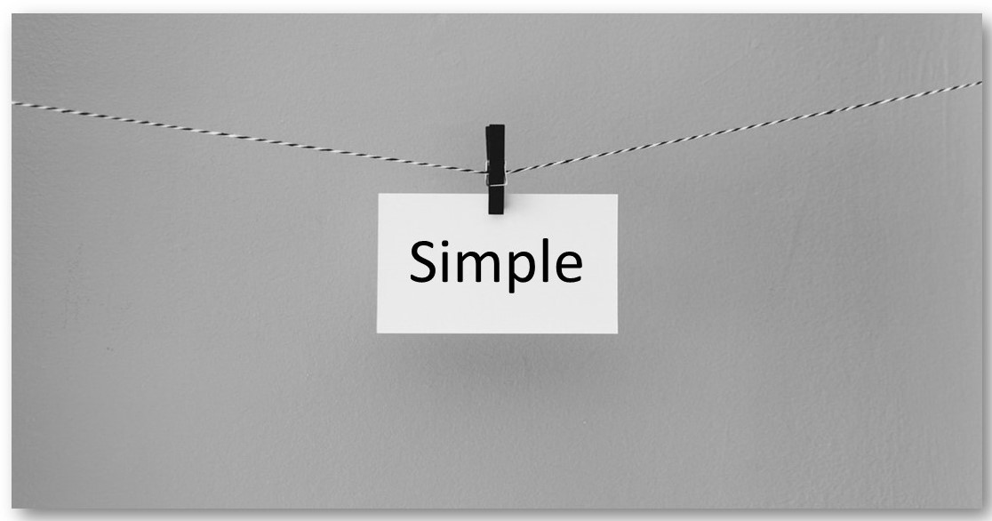
Can simple things make a big difference?
(Open Discussion)

Slide 6
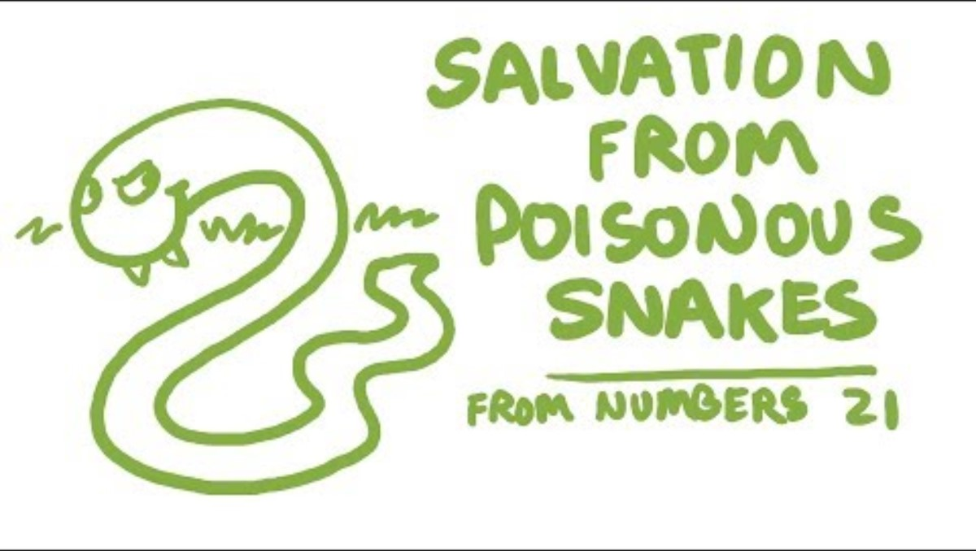
Numbers 21
https://www.youtube.com/watch?v=UrRKZuYkE-w&t=44s

Slide 7
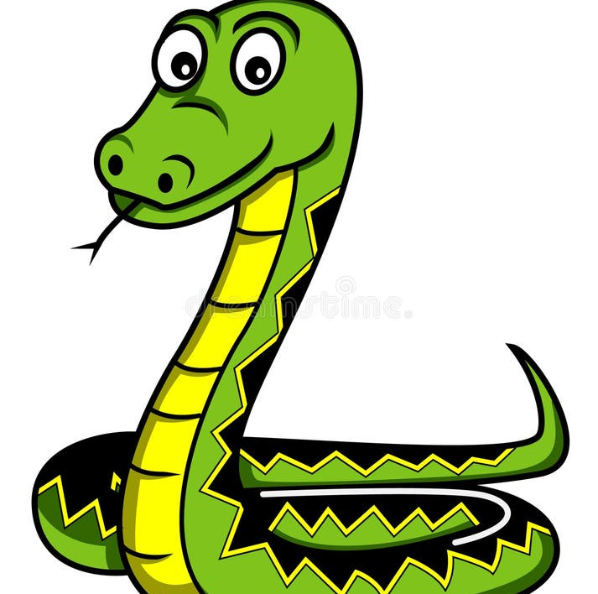
FAST BREAK
What was the serpent on the pole made of? (Prize: 2 candies)
Why did God send the serpents? (Prize: 4 candies)
What were the serpents that bit the Israelites called? (Prize: 2 candies)
Did God take away the serpents after Moses prayed? (Prize: 2 candies)
What did Jesus say to Nicodemus about the bronze snake? (Prize: 5 candies)

Slide 8
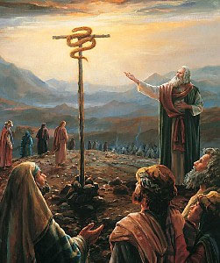
Look not Worship
Was not an idol
Was not a source of healing
Was a reminder of who their healing came from
Was a place to trust God
Was a sign of God's mercy
Was a place to put aside pride and self-sufficiency
Was a foreshadowing of something greater

Slide 9



Fun Fact
The bronze serpent likely influenced the modern day symbol of Medicine
Rod of Asclepius is the name of the symbol
Greeks were most likely influenced by this symbol from the Israelites, through their interactions with the tribe of Dan, and incorporated it into their own mythology
Notes:
The Bronze Snake did later become an idol (Nehushtan)
They took the good that God had given them an turned it into something to worship instead of God
King Hezekiah later broke down the statue because the israelites were worshipping it

Slide 10

Would you rather work hard to get something or get something for free?
(Open Discussion)

Slide 11

The Foreshadowing of Something Better
The Bronze Snake
Jesus' Crucifixion
Was a response to sinful behaviors
Was a place to look for healing from a deadly snake bite
Not looking results in physical death
The healing could not be earned
Required faith to be saved
There was no other solution that could heal them
Being healed did not mean you would never be bitten again
This was a temporary solution
Is a response to all of our sin
Was a place that healed us from the penalty of sin
Not looking results in spiritual death
Salvation cannot be earned
Requires faith to be saved
There is no other way to be saved
Just because we accept it does not mean we will never fall into sin again
This is an eternal solution

Slide 12
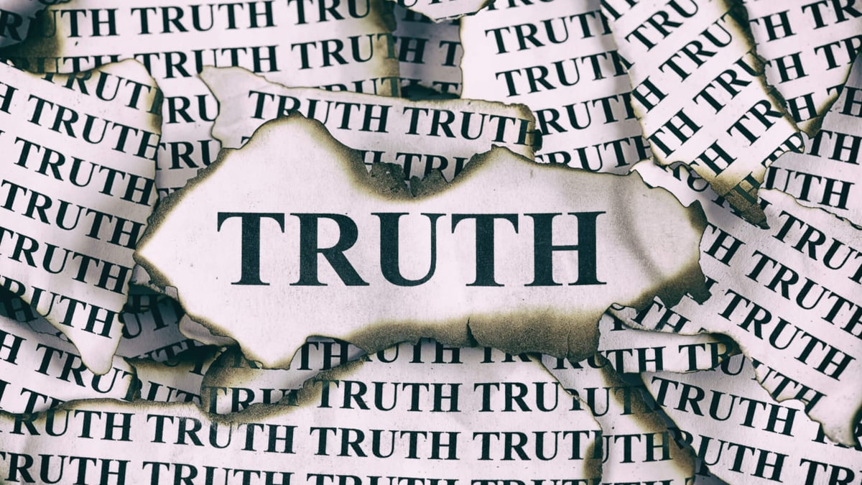
The Hard Truth of Salvation
Your Salvation is your responsibility
There is no good deed that can get you salvation
Salvation is simple unless you complicate it
Salvation through Christ alone is an act of mercy in justice
You can't clean yourself up for salvation
Your Salvation has a time limit (End of time or the end of your time) – don't wait!

Slide 13

The Gift of Salvation
John 3:16–17 - For God so loved the world that he gave his one and only Son, that whoever believes in him shall not perish but have eternal life. For God did not send his Son into the world to condemn the world, but to save the world through him.
Romans 3:23–24 - “For all have sinned and fall short of the glory of God, and all are justified freely by his grace through the redemption that came by Christ Jesus.”
Ephesians 2:8–9 - For it is by grace you have been saved, through faith—and this is not from yourselves, it is the gift of God—not by works, so that no one can boast.
Titus 3:5 - He saved us, not because of works done by us in righteousness, but according to his own mercy, by the washing of regeneration and renewal of the Holy Spirit.
Romans 6:23 - For the wages of sin is death, but the gift of God is eternal life in Christ Jesus our Lord.
John 1:12–13 - Yet to all who did receive him, to those who believed in his name, he gave the right to become children of God—children born not of natural descent, nor of human decision or a husband’s will, but born of God.
2 Timothy 1:9 - He saved us and called us to a holy calling, not because of our works but because of his own purpose and grace, which he gave us in Christ Jesus before the ages began.
Romans 3:23–24 - For all have sinned and fall short of the glory of God, and all are justified freely by his grace through the redemption that came by Christ Jesus.

Slide 14
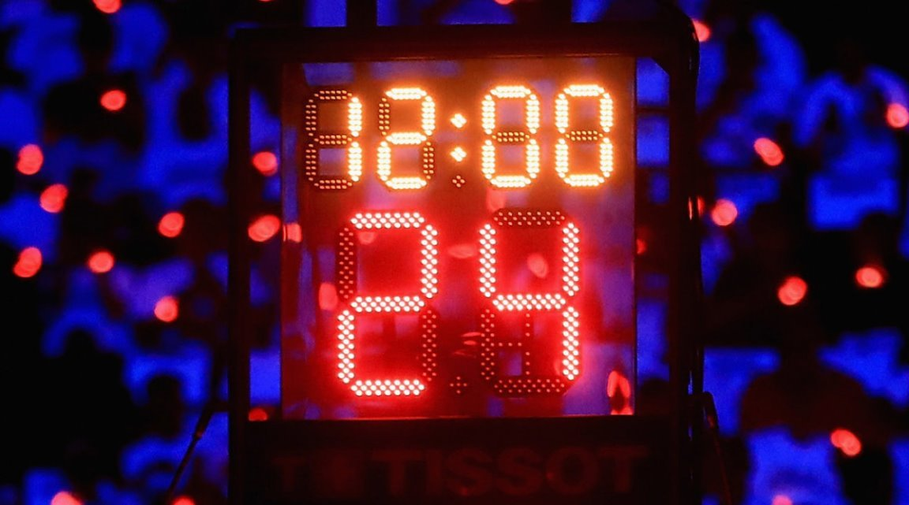
OVERTIME
Where can we see modern day influences of the bronze serpent? (Prize: 3 candies)
What did the Israelites do with the bronze snake after they entered the Promised land? (Prize: 4 candies)
What were the poisonous snakes and the bronze serpent foreshadowing? (Prize: 2 candies)
Can you earn your salvation? (Prize: 4 candies)
Bonus: How many verses on salvation did I read to you? (Prize: 3 candies)

Slide 15

Questions

Slide 16
Take the Free Gift Romans 10:9 If you declare with your mouth, “Jesus is Lord,” and believe in your heart that God raised him from the dead, you will be saved.
Dear God,
Thank you for sending your son Jesus to die on a cross
to pay the price for my sins and to give me a new life through Him.
Today I accept Jesus as my savior,
I surrender my life to You God,
Guide me and lead me from this day forward.
Amen

